Slide 1
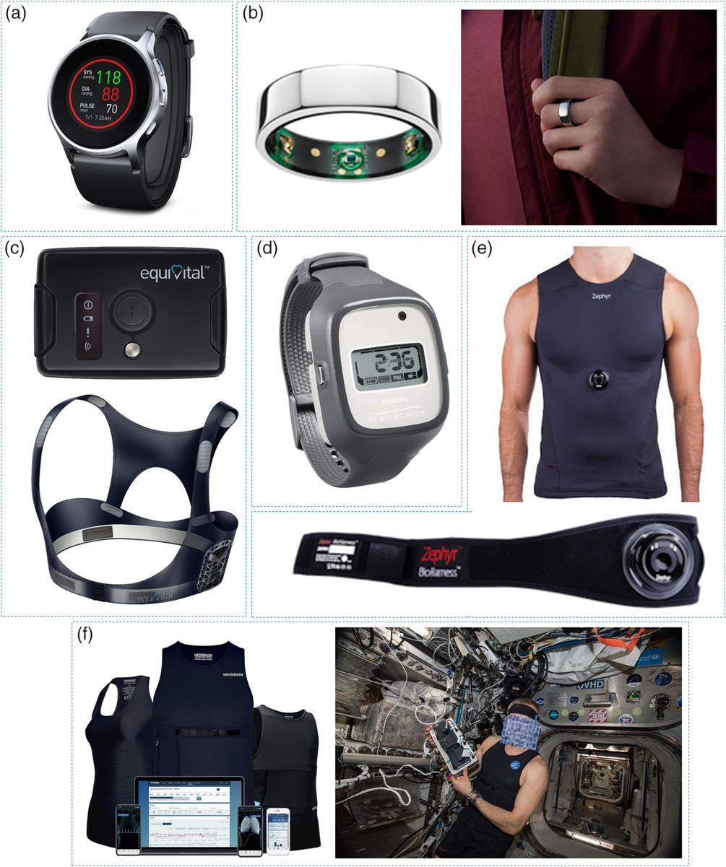
Trends in Workplace Wearable Technologies and Connected‐Worker Solutions for Next‐Generation Occupational Safety, Health, and Productivity
Examples of wearables for physical activity monitoring. a) Omron's HeartGuide BP8000-M tracks the user's aerobic steps, calories burned, and blood pressure. b) The Oura Ring monitors the heart rate, body temperature, activity, calories burned, respiratory rate, and sleep. c) Equivital's LifeMonitor is a mobile human monitoring system that continuously measures the user's galvanic skin response, respiratory rate, heart rate, ECG data, and activity. d) The Philips Actiwatch Spectrum Plus measures activity and cycles of being awake or asleep. e) The Zephyr BioHarness is a physiological monitoring device with telemetry for tracking the activity, body orientation, ECG data, heart rate, and breathing rate. f) Hexoskin Smart Garments monitor the user's cadence, activity, acceleration, heart rate, and breathing rate.
Advanced Intelligent Systems, Volume: 4, Issue: 1, First published: 23 September 2021, DOI: (10.1002/aisy.202100099)
Notes:
Examples of wearables for physical activity monitoring. a) Omron's HeartGuide BP8000‐M tracks the user's aerobic steps, calories burned, and blood pressure. b) The Oura Ring monitors the heart rate, body temperature, activity, calories burned, respiratory rate, and sleep. c) Equivital's LifeMonitor is a mobile human monitoring system that continuously measures the user's galvanic skin response, respiratory rate, heart rate, ECG data, and activity. d) The Philips Actiwatch Spectrum Plus measures activity and cycles of being awake or asleep. e) The Zephyr BioHarness is a physiological monitoring device with telemetry for tracking the activity, body orientation, ECG data, heart rate, and breathing rate. f) Hexoskin Smart Garments monitor the user's cadence, activity, acceleration, heart rate, and breathing rate. a) Reproduced with permission.[186] Copyright 2021, Omron; b) Reproduced with permission.[229] Copyright 2021, Oura; c) Reproduced with permission.[83] Copyright 2021, Equivital; d) Reproduced with permission.[129] Copyright 2021, Philips; e) Reproduced with permission.[81] Copyright 2021, Zephyr; and f ) Reproduced with permission.[233] Copyright 2021, Hexoskin.
IF THIS IMAGE HAS BEEN PROVIDED BY OR IS OWNED BY A THIRD PARTY, AS INDICATED IN THE CAPTION LINE, THEN FURTHER PERMISSION MAY BE NEEDED BEFORE ANY FURTHER USE. PLEASE CONTACT WILEY'S PERMISSIONS DEPARTMENT ON PERMISSIONS@WILEY.COM OR USE THE RIGHTSLINK SERVICE BY CLICKING ON THE 'REQUEST PERMISSIONS' LINK ACCOMPANYING THIS ARTICLE. WILEY OR AUTHOR OWNED IMAGES MAY BE USED FOR NON-COMMERCIAL PURPOSES, SUBJECT TO PROPER CITATION OF THE ARTICLE, AUTHOR, AND PUBLISHER.

